Slide 1

AI and Machine Learning Application to Electrical Engineering
BIRLA VISHVAKARMA MAHAVIDYALAYA
EE441: ELECTRICAL PROJECT
END SEMESTER EXAMINATION
Group No:1
Group Members: Guided By:
SAMANI BHAVESH (17EE055) Dr. Rashesh P. Mehta
YADAV JAGDISH(17EE057) Prof. Jaydeepsinh C. Baria
Department of Electrical Engg
BVM Engineering College

Slide 2
Flow of Presentation
Over view
Problem Definition
Objective of Project
Literature Review
Results and Analysis
Hardware and Software development
Conclusion
References

Slide 3
Over view:
What is the Meaning of Artificial Intelligence (AI) and Machine Learning (ML)?
Artificial intelligence and machine learning are the part of computer science that are correlated with each other. which are used for creating intelligent systems.
Machine learning is an application of artificial intelligence (AI) that provides systems the ability to automatically learn, improve from experience and then future data can be predicted.

Slide 4
AI and ML Application to Electrical Engineering:
Load forecasting.
Fault detection and classification in electrical power transmission system.
Load classification in power system.
Reactive power planning and its control.
Identifying optimal location for the installation of DG units and capacitor bank in the Distribution Systems.
Speed control of the machine.

Slide 5
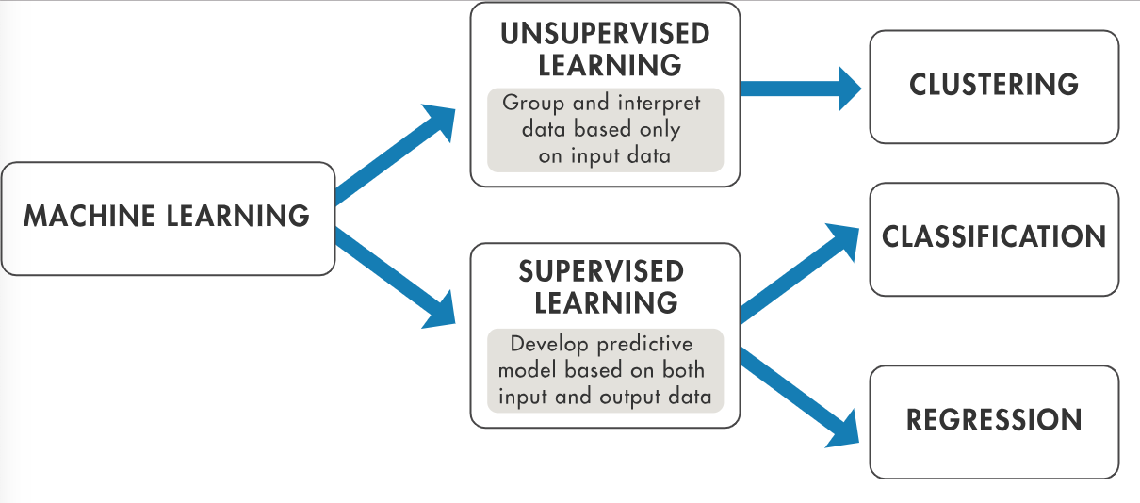
Different ML Libraries and Algorithms for This Project:
NO. | Library name: | Feature of library:
1. | Numpy | N- darray, mathematics operation
2. | pandas | Data-frame
3. | matplotlib | Plotting library
4. | scikit-learn. | Machine learning tools.

Slide 6
Problem Definition & Objective of Project
Model 1: To predict the power generation in India using Linear regression Model.
Model 2: To predict the power generation with higher accuracy(above 99%) using polynomial regression Model .
Model 3: Clustering Analysis and its Application in Electrical Distribution System using K-means clustering Model.

Slide 7
Model 4: Clustering Analysis and its Application in Electrical Distribution System using Hierarchical clustering Model.
Model 5: Load classification and Fault classification using k-nearest neighbors (KNN) Model.

Slide 8
Literature Review :
Following are the research paper which we have referred for our project at the various point:
Clustering Analysis and its Application in Electrical Distribution System.
[N.V.V.Karunakar.Jureedi, K.M.Rosalina, N. Prema Kumar]
http://irdindia.in/journal_ijraet/pdf/vol8_iss6/6.pdf
Fault detection and classification in electrical power transmission system using artificial neural network.
[Majid Jamil, Sanjeev Kumar Sharma and Rajveer Singh]
https://springerplus.springeropen.com/track/pdf/10.1186/s40064-015-1080-x.pdf

Slide 9
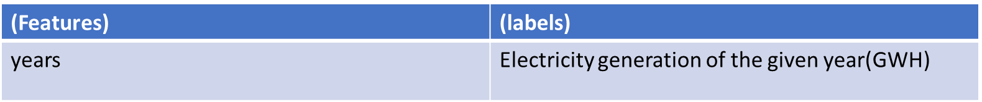
Model 1: Linear Regression:
In this model we will give the data of gross electricity generation(GWH) of the past years(2000 to 2020) to the model and then we will try to predict the requirement of the total power generation in the future with specific accuracy.

Slide 10
What is the Linear Regression?
Linear regression is the next step up after correlation. It is used when we want to predict the value of a variable based on the another variable. The variable we want to predict is called the dependent variable
Training and Testing Data:
Now, entire dataset is divided into training and testing set so that prediction does not over fit or under fit and correct values are obtained. train_test_split() is inbuilt function from scikit learn for splitting x and y variables data. “test_size” parameter is used for testing data and remaining as training data.

Slide 11
Working of Linear Regression:
First we will give the training data to the model.
Model will draw the best fit line using line formula and SSR.
Formula: y=mx+c
where y is the dependent variable, m is slope, x is the independent variable and c is the intercept for a given line.
SSR= sum of square of error.
Model will try to reduce the error by taking the different values of slop (m) and intercept(c).
Finally the best fit line will be drawn using this method.

Slide 12
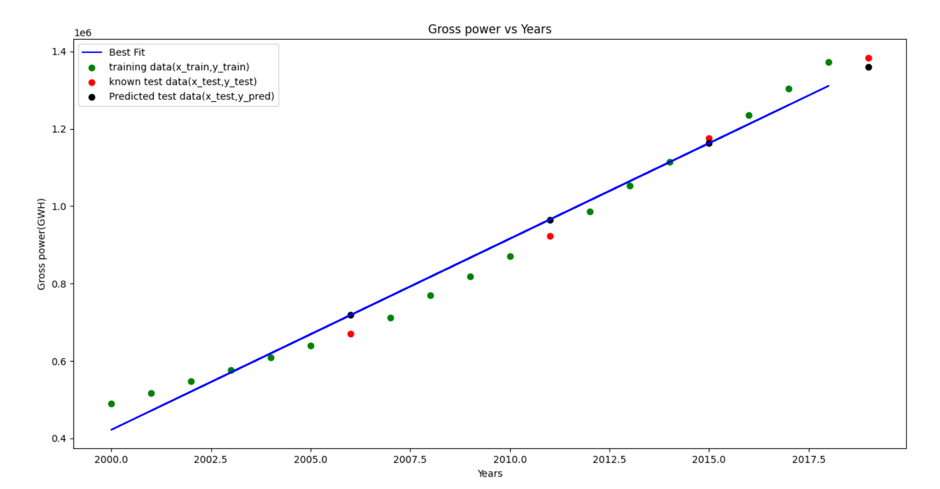
Linear Regression Model:
Fig : [output of model when dataset is linear]

Slide 13
Measurement of Model’s Accuracy:
The formula is (1-SSE/SSM)*100
SSE=Sum of square of error(y-yi)
Y=actual data , Yi=predicted data.
SSM=sum of square of M.
Where, M→ (y-(arithmetic mean of the y))

Slide 14
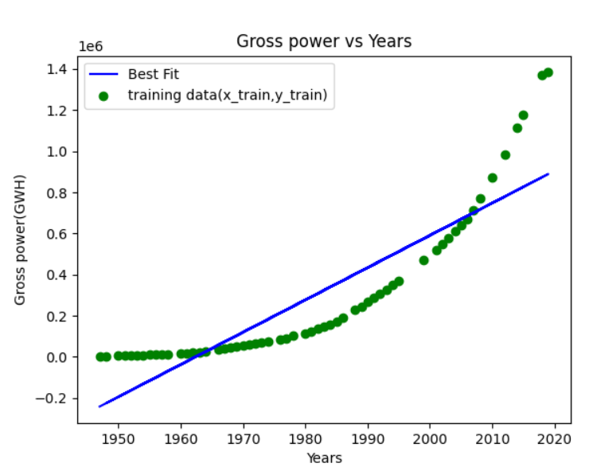
Fig : [Output of this model when dataset is not linear(1950 to 2020).]

Slide 15
Conclusion :
If we want to predict the future power generation using dataset 1(from 2000 to 2020) then only we can use this model. We got 96% accuracy.
If we want to use dataset 2(from 1950 to 2020) then accuracy will be reduced as shown in above figure. We got 52% accuracy.

Slide 16
Model 2: Polynomial Regression Model
Definition:
Polynomial Regression is a regression algorithm that models the relationship between a dependent(y) and independent variable(x) as nth degree polynomial.
The Polynomial Regression equation is given below:
y= b₀+b₁x₁+ b₂x₁²+ b₂x₁³+...... b_{n}x₁^{n}

Slide 17
It is also called the special case of Linear Regression in ML. Because we add some polynomial terms to the Multiple Linear regression equation to convert it into Polynomial Regression.
It is a linear model with some modification in order to increase the accuracy.
The dataset used in Polynomial regression for training is non-linear nature.
It makes use of a linear regression model to fit the complicated and non-linear
functions and datasets.
In Polynomial regression, the original features are converted into Polynomial features of required degree (2,3,..,n) .

Slide 18
Need for Polynomial Regression:
The need of Polynomial Regression in ML can be understood in the below points:
If we apply a linear model on a linear dataset, then it provides us a good result as we have seen in Simple Linear Regression, but if we apply the same model without any modification on a non-linear dataset, then it will produce a drastic output. Due to which loss function will increase, the error rate will be high, and accuracy will be decreased.
So for such cases, where data points are arranged in a non-linear fashion, we need the Polynomial Regression model. We can understand it in a better way using the below comparison diagram of the linear dataset and non-linear dataset.

Slide 19
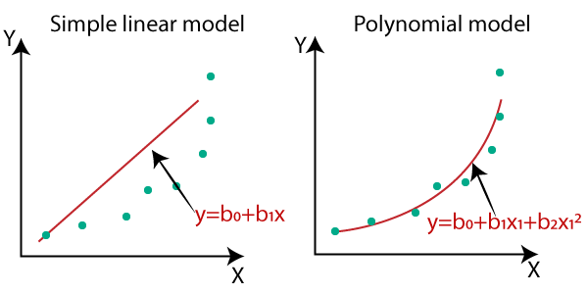
In the above image, we have taken a dataset which is arranged non-linearly. So if we try to cover it with a linear model, then we can clearly see that it hardly covers any data point.
On the other hand, a curve is suitable to cover most of the data points, which is of the Polynomial model.

Slide 20
Block Diagram of the Model 2:
Splitting of training data and testing data
If the accuracy is less than 85%
Then change the value of degree.
Model is ready to predict the data.
Training data will be given to the model
We will check the accuracy
If the accuracy > 85%
Learning Algorithm
Best fit curve will be drawn
Testing data will be given to model for checking accuracy.

Slide 21
Conclusion :
If the datasets are arranged in a non-linear fashion, then we should use the Polynomial Regression model instead of Simple Linear Regression to get higher accuracy (above 99%).

Slide 22
Model 3:
Clustering Analysis and its Application in Electrical Distribution System using K-means Clustering Model.
Application:
Identifying optimal location for the installation of DG units in Radial Distribution Systems using “K-means cluster” technique.

Slide 23
Introduction of the Distributed Generation :
Distributed Generation (DG) in the form of renewable power generation systems is currently preferred for clean power generation.
In distribution system, due to load uncertainties the load exceeds the generating capacity which leads to power loss and unreliable operation of the system.
To overcome this problem DG units are incorporated into the distribution system to meet the excess demand which results in power loss minimization, improvement of voltage profile, power quality improvement, reliable operation, etc.,

Slide 24
What is K-Means Algorithm?
K-Means Clustering is an Unsupervised Learning algorithm, which groups the unlabeled dataset into different clusters.
It is an iterative algorithm that divides the unlabeled dataset into k different clusters in such a way that each dataset belongs only one group that has similar properties.
Here K defines the number of pre-defined clusters that need to be created in the process,
as if K=2, there will be two clusters, and for K=3, there will be three clusters, and so on..

Slide 25
The algorithm takes the unlabeled dataset as input, divides the dataset into k-number of clusters, and repeats the process until it does not find the best clusters. The value of k should be predetermined in this algorithm.
The k-means clustering algorithm mainly performs two tasks:
Determines the best value for K using Elbow Method.
Assigns each data point to its closest k-center.

Slide 26
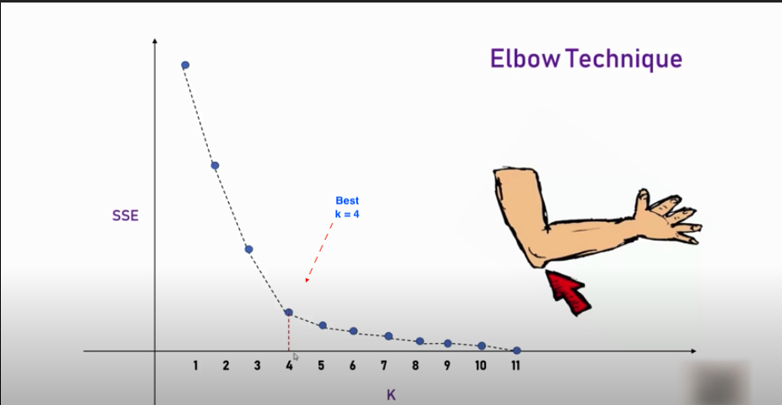
What is the Elbow Method ?
Fig: Elbow method to find the clusters in K-means model.

Slide 27
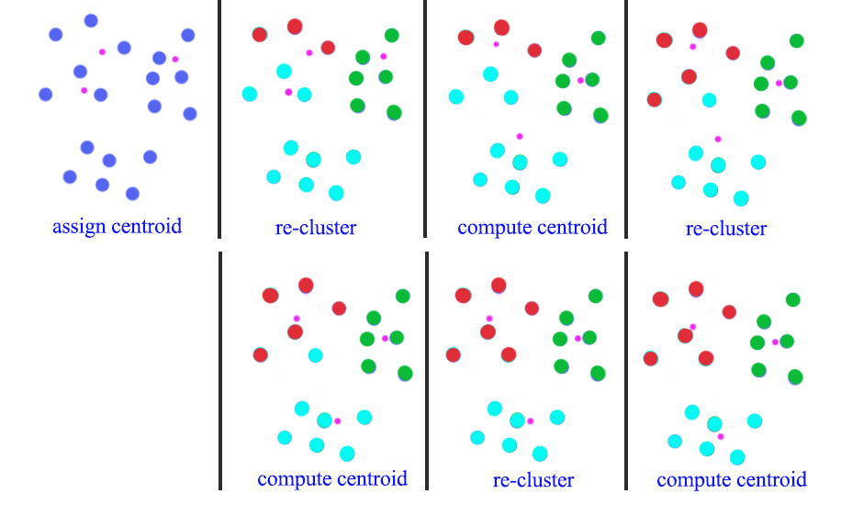
The Working of K-means Cluster:

Slide 28
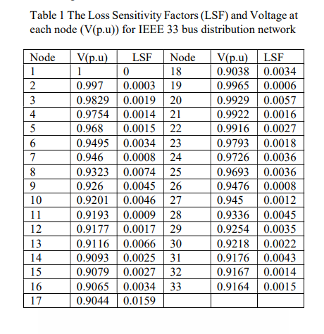
Input of the Model:

Slide 29
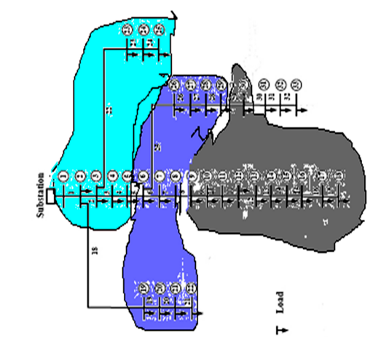
Output of the Model:

Slide 30
Model 4:Hierarchical Clustering
Hierarchical clustering is another unsupervised machine learning algorithm, which is used to group the unlabeled datasets into a cluster and also known as hierarchical cluster analysis or HCA.
In this algorithm, we develop the hierarchy of clusters in the form of a tree, and this tree-shaped structure is known as the dendrogram.
There is no requirement to predetermine the number of clusters as we did in the K-Means algorithm.

Slide 31
Why Hierarchical Clustering?
we have seen in the K-means clustering that there are some challenges with this algorithm, which are a predetermined number of clusters. To solve challenge, we can use the hierarchical clustering algorithm because, in this algorithm, we don't need to have knowledge about the predefined number of clusters(k).
The Hierarchical Clustering Technique has Two Approaches:
Agglomerative: Agglomerative is a bottom-up approach, in which the algorithm starts with taking all data points as single clusters and merging them until one cluster is left.
Divisive: Divisive algorithm is the reverse of the agglomerative algorithm as it is a top-down approach.

Slide 32
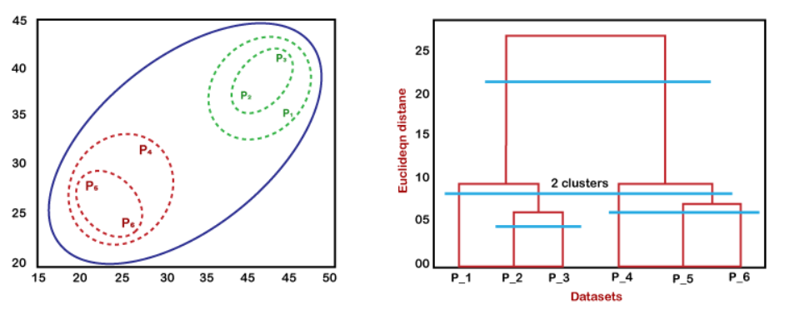
Fig: Hierarchical clustering

Slide 33
Conclusion of the Model 3 & 4:
The output of the Hierarchical clustering is almost similar to the K-means clustering, so we can say that our model is reliable.
So, with the help of this model we can predict the location of DG units in the distribution system.

Slide 34
Model 5: Load classification and Fault classification using k-nearest neighbors (KNN) Model.
Load classification:
In the output of previous model ( clustering model ) , we got three clusters(D.G.) for different load .
In this system, if we want to connect a new load to the D.G. then there are 3 ways (DG1,DG2,DG3) but which one would be the best choice?
To get answer of this, we are going to use KNN classification model .

Slide 35
Fault classification:
In this, we are going to classify the most common fault (Line-Ground) that occur in the power system.
It enables us to differentiate among three phases which phase of a three phase power system is experiencing a fault.
To classify the single line to ground fault, we are going to use KNN classification model .

Slide 36
K-Nearest Neighbor(KNN) Algorithm:-
K-Nearest Neighbour is one of the simplest Machine Learning algorithms based on Supervised Learning technique.
K-NN algorithm assumes the similarity between the new data and available data and put the new case into the category that is most similar to the available categories.
KNN algorithm at the training phase just stores the dataset and when it gets new data, then it classifies that data into a category that is much similar to the new data.

Slide 37
How to select the value of K in the K-NN Algorithm?
Below are some points to remember while selecting the value of K in the K-NN algorithm:
There is no particular way to determine the best value for "K", so we need to try some values to find the best out of them. The most preferred value for K is 5.
A very low value for K such as K=1 or K=2, can be noisy and lead to the effects of outliers in the model.
Large values for K are good, but it may find some difficulties.
So, we will use the k=5 in our model.

Slide 38
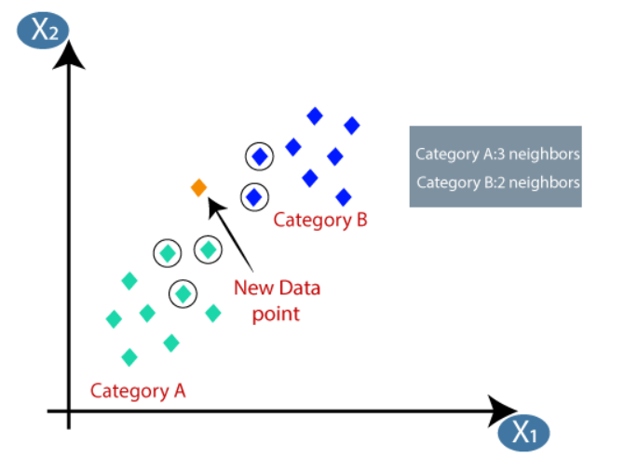
Fig: K-Nearest Neighbor Algorithm(k=5)

Slide 39
Conclusion :
With the help of this model (“K-Nearest Neighbor (KNN) Algorithm”) we can identify the optimal cluster (D.G.) for the new load in power system and we can also differentiate among three phases which phase of a three phase power system is experiencing a fault with specific accuracy.
We got 100% accuracy as shown in above figure.

Slide 40
References:
https://www.javatpoint.com/machine-learning
https://www.coursera.org/learn/machine-learning
https://www.youtube.com/user/krishnaik06 (K-means & Hierarchical clustering ,Regression)
https://www.youtube.com/c/sentdex (KNN classification.)
https://www.youtube.com/watch?v=HVXime0nQeI&list=PLblh5JKOoLUICTaGLRoHQDuF_7q2GfuJF&index=38 (KNN classification)
http://irdindia.in/journal_ijraet/pdf/vol8_iss6/6.pdf (K-means clustering and Hierarchical clustering.)
https://springerplus.springeropen.com/track/pdf/10.1186/s40064-015-1080-x.pdf (KNN classification)

Slide 41
Thank You

